Slide 1
Evolution of TC39 Proposals

Slide 2
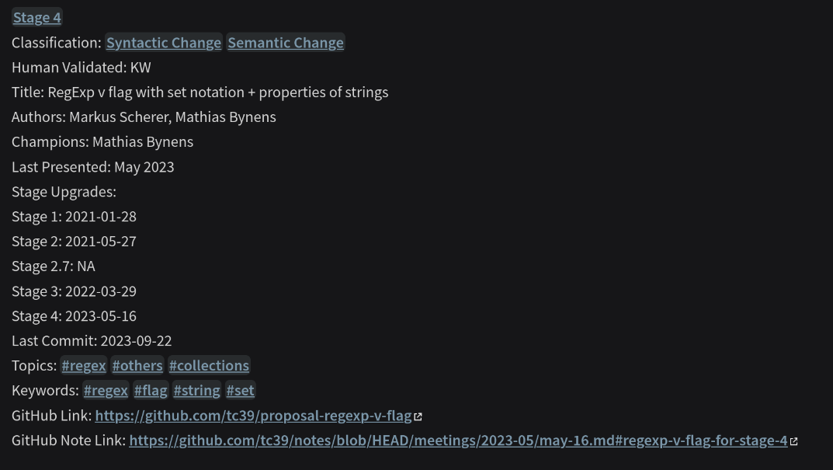
Project Aims
Collect proposal data
  Snapshot from Feb 2025
  From TC39/proposals repositories
Classify proposals
  Stage
  Change type
  Topics and keywords
  Present on website
Analyse evolution of proposals
  Pattern in stage bumps?
  Pattern in stage duration?
  Topic dependent?
  Time dependent?
https://js-proposals.vercel.app/

Slide 3
How?
Data:
  Retrieve data via Github API – TC39/Proposals
  Parse the data, create .md files and saved in Obsidian
  GPT assistance – Classifications, Stage bumps from commit messages, keywords
  Manually verified and curated
  Data analysis done in R and Rstudio
Website:
  Quartz: Open source static page generator with Obsidian compatibilty
  Demonstration

Slide 4
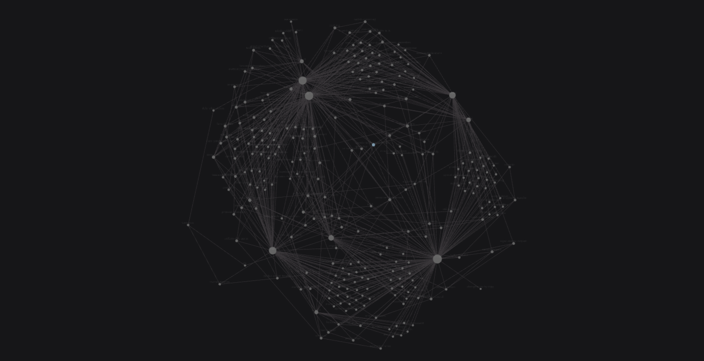

Slide 5
Classifications
API Change
  Modifies or introduces new functions, objects, or methods in the standard library. These changes do not affect the syntax of the language but add new functionality to existing features.
Semantic Change
  Changes the meaning of the JavaScript code even if the syntax remains the same. These changes can alter the behavior of existing JavaScript programs in subtle or breaking ways. Usually involves modifying execution rules rather than introducing new syntax.
Syntactic Change:
  Introduces new syntax or modifies existing syntax rules. Usually involves new keywords, operators, or expressions. These changes often require updates to parsers and affect how JavaScript code is written.

Slide 6
Observations

Slide 7
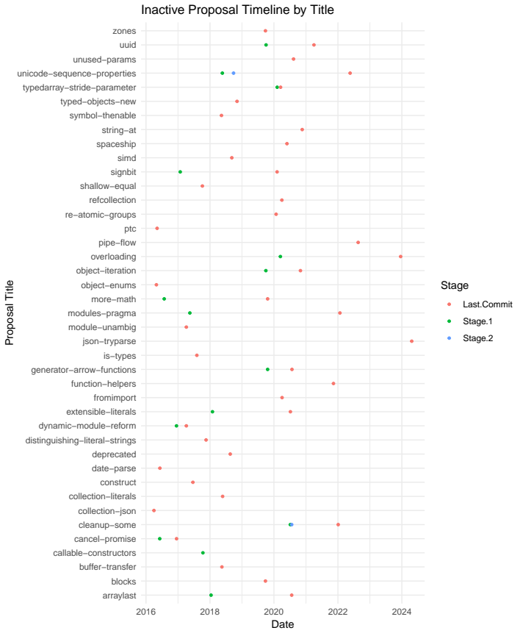
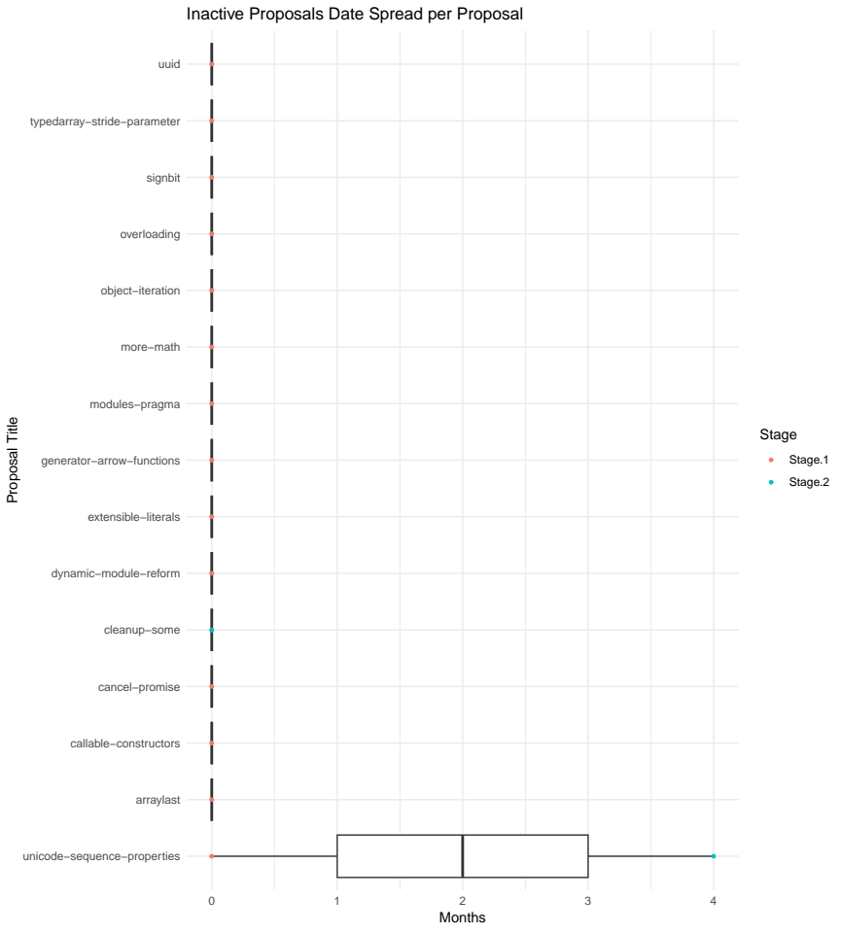
Inactive

Slide 8
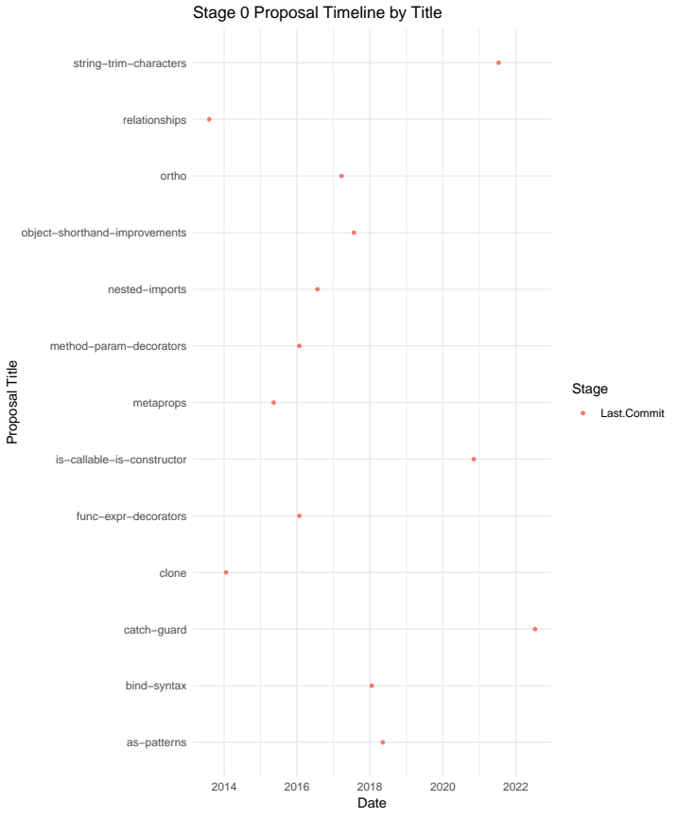
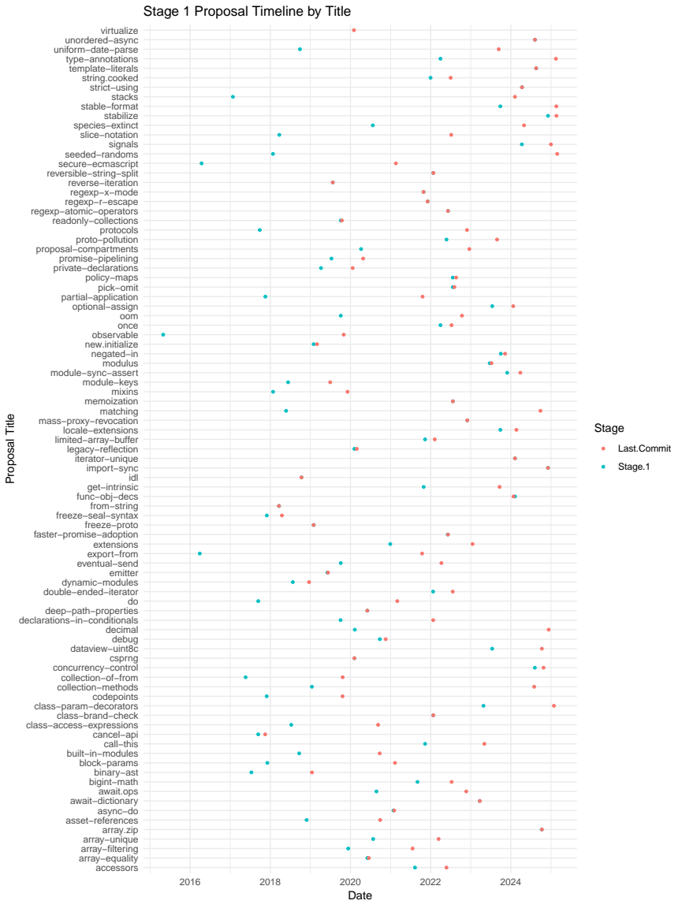
Stage 0 Stage 1

Slide 9
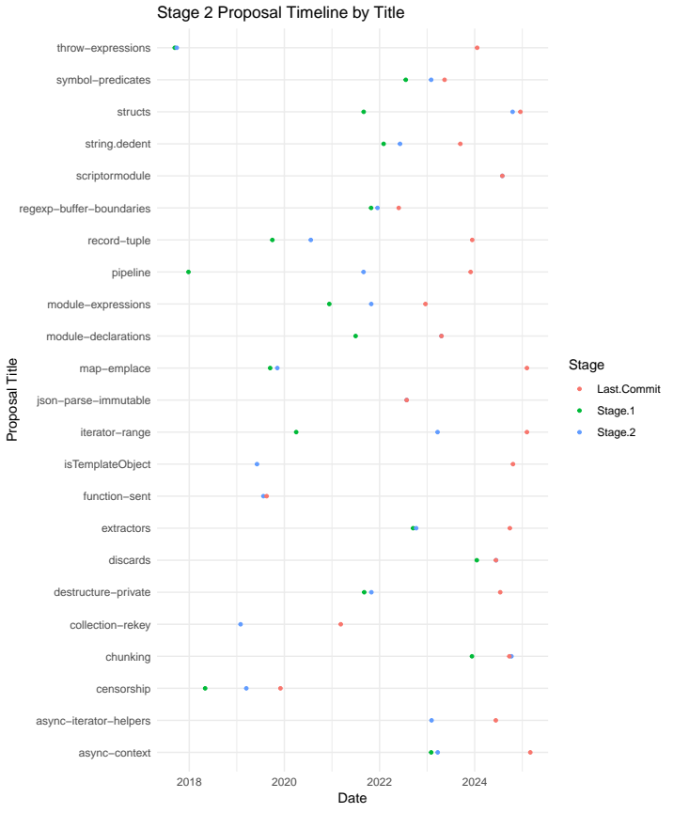
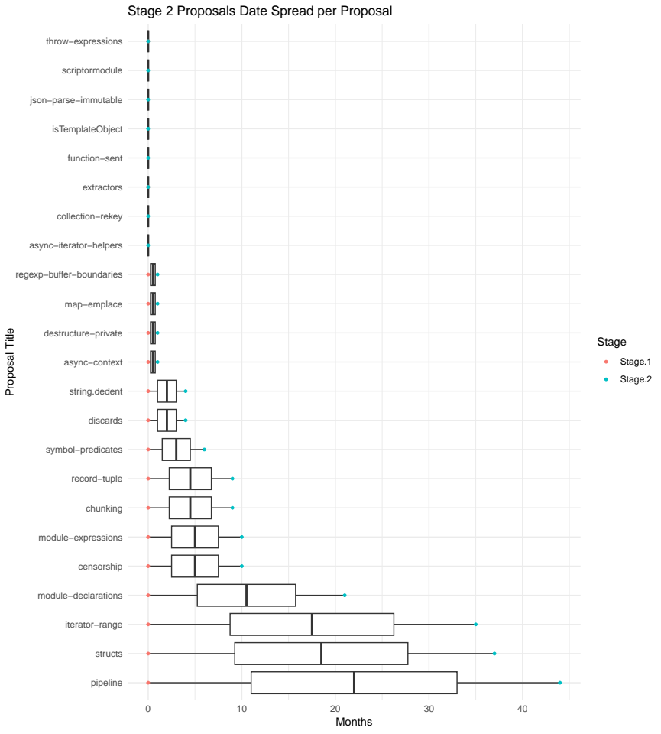
Stage 2

Slide 10
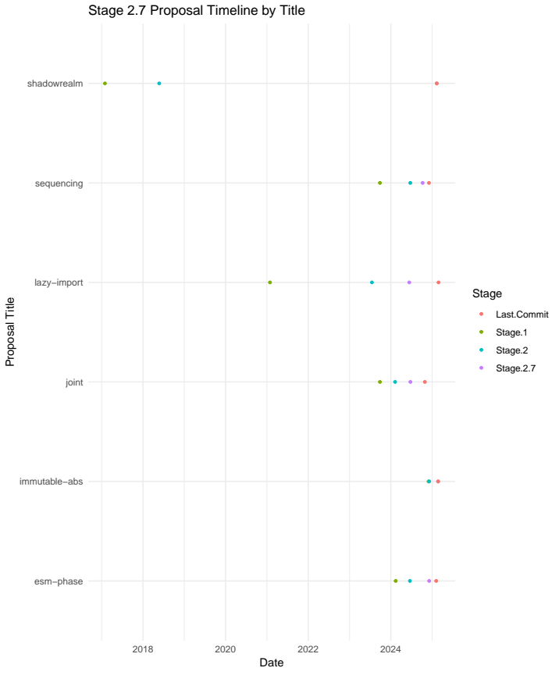
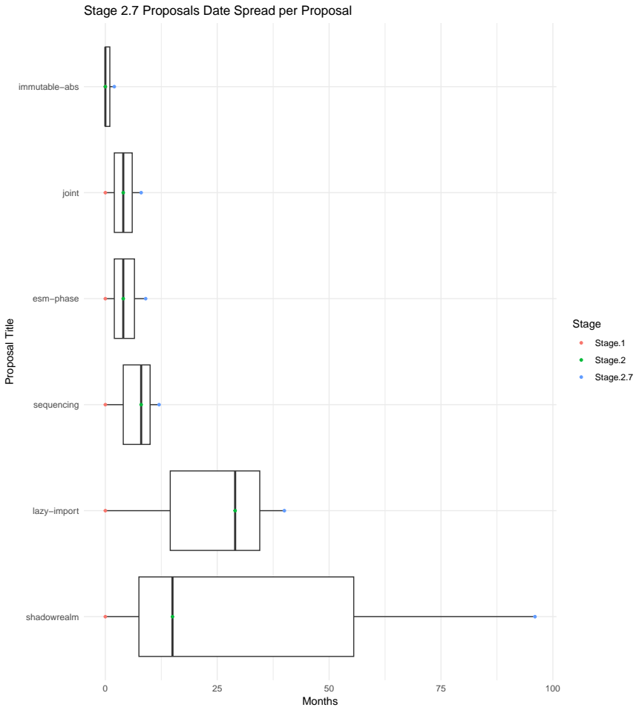
Stage 2.7

Slide 11
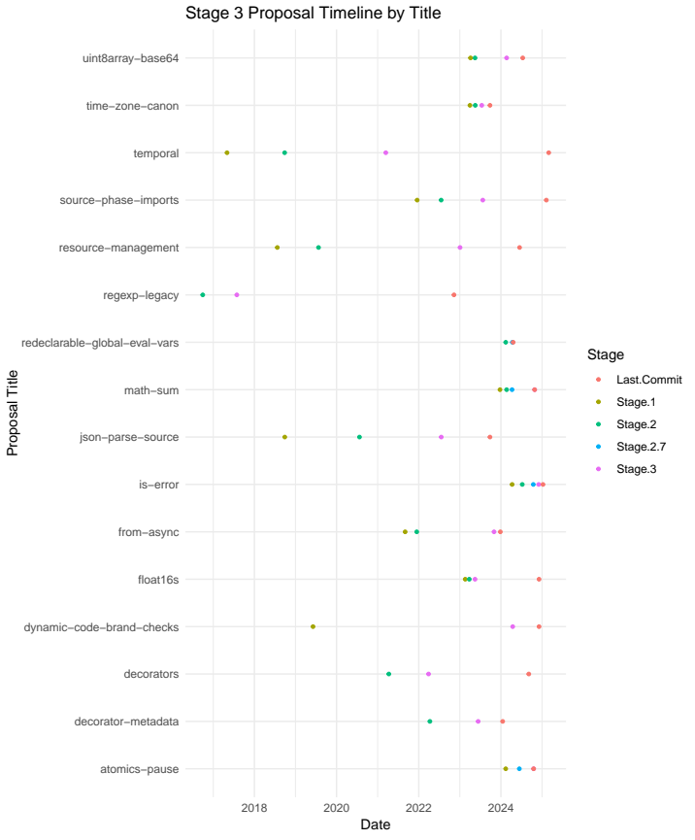
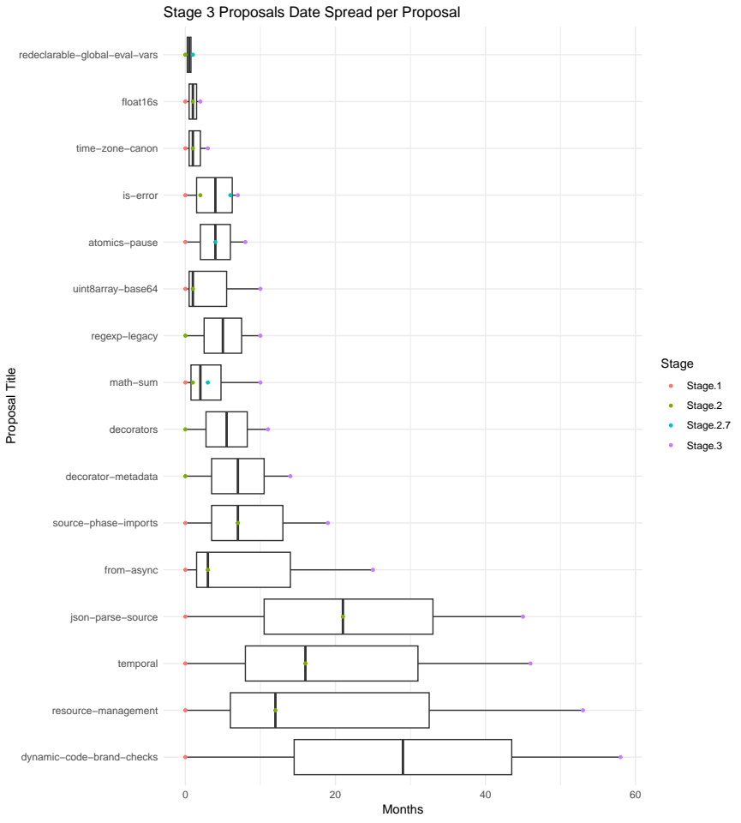
Stage 3

Slide 12
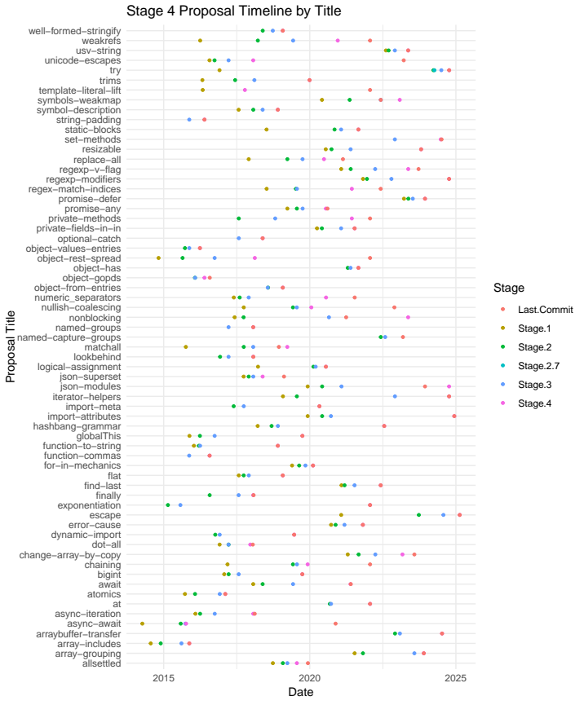
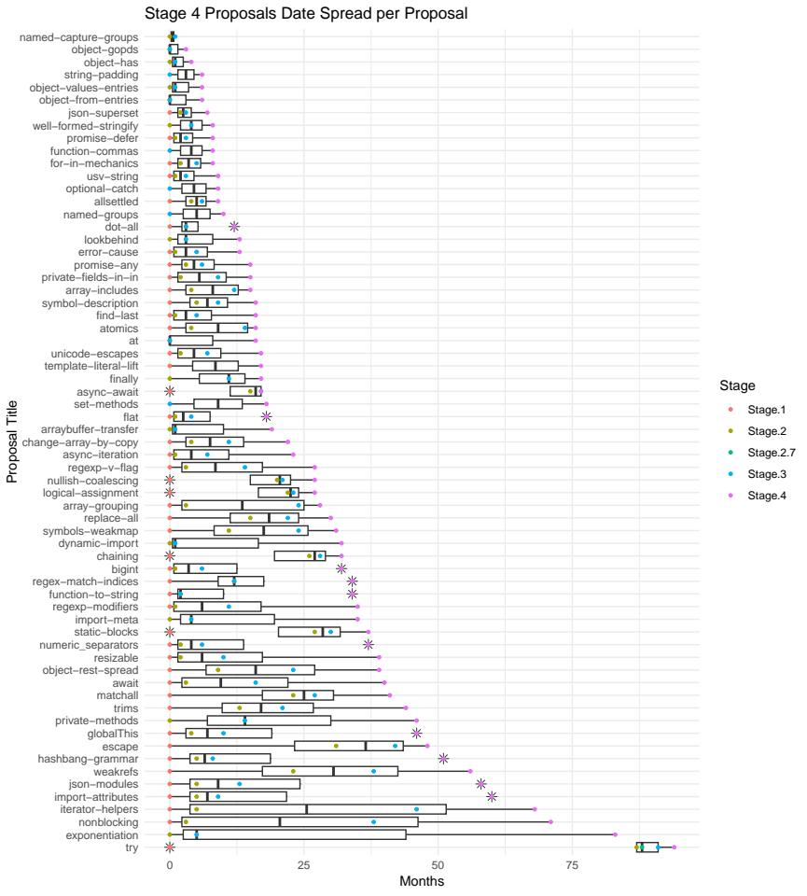
Stage 4

Slide 13
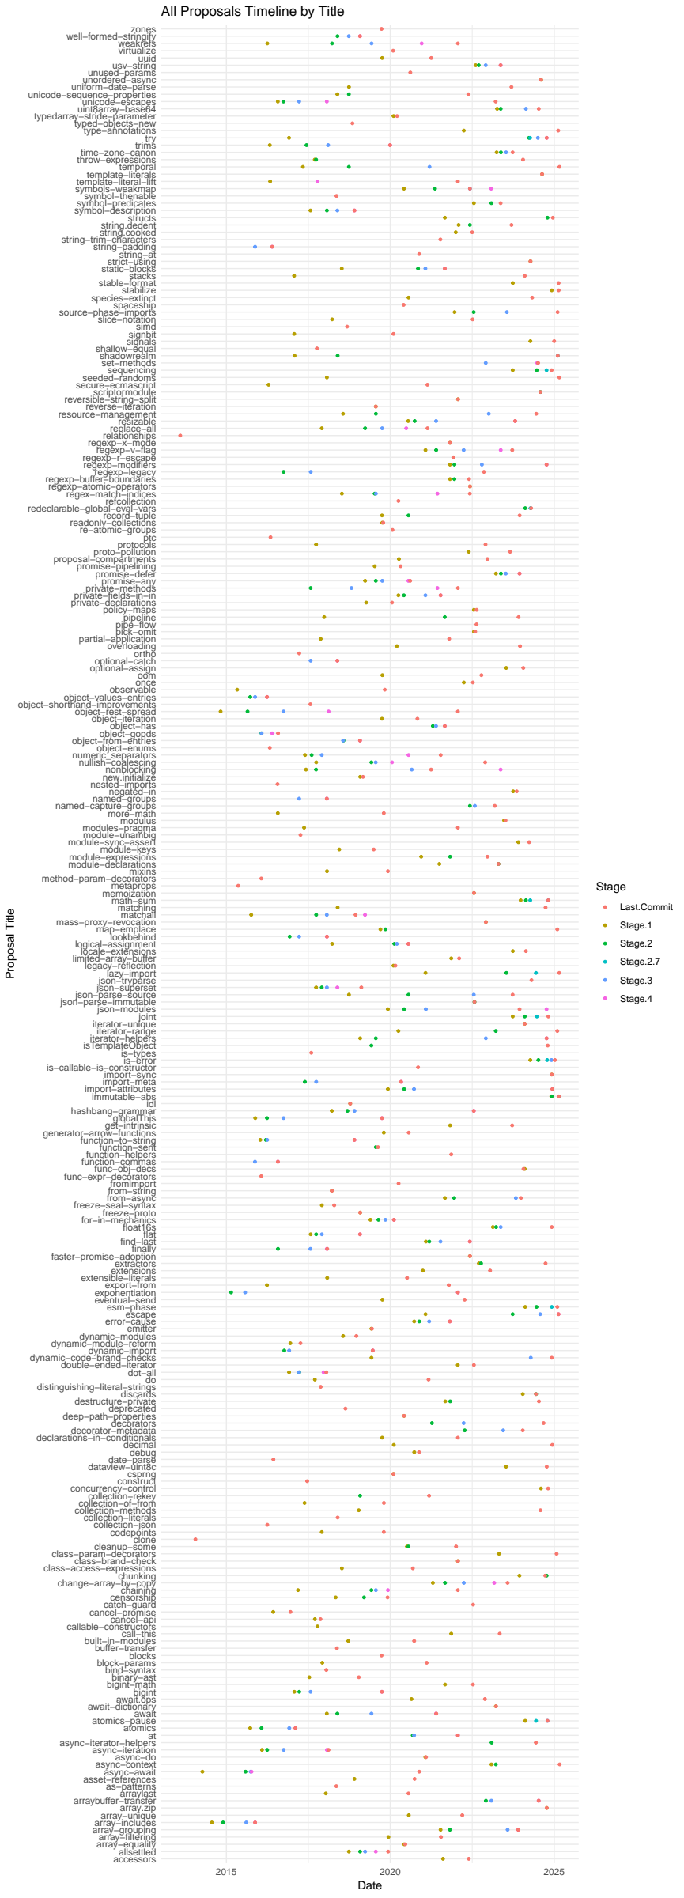
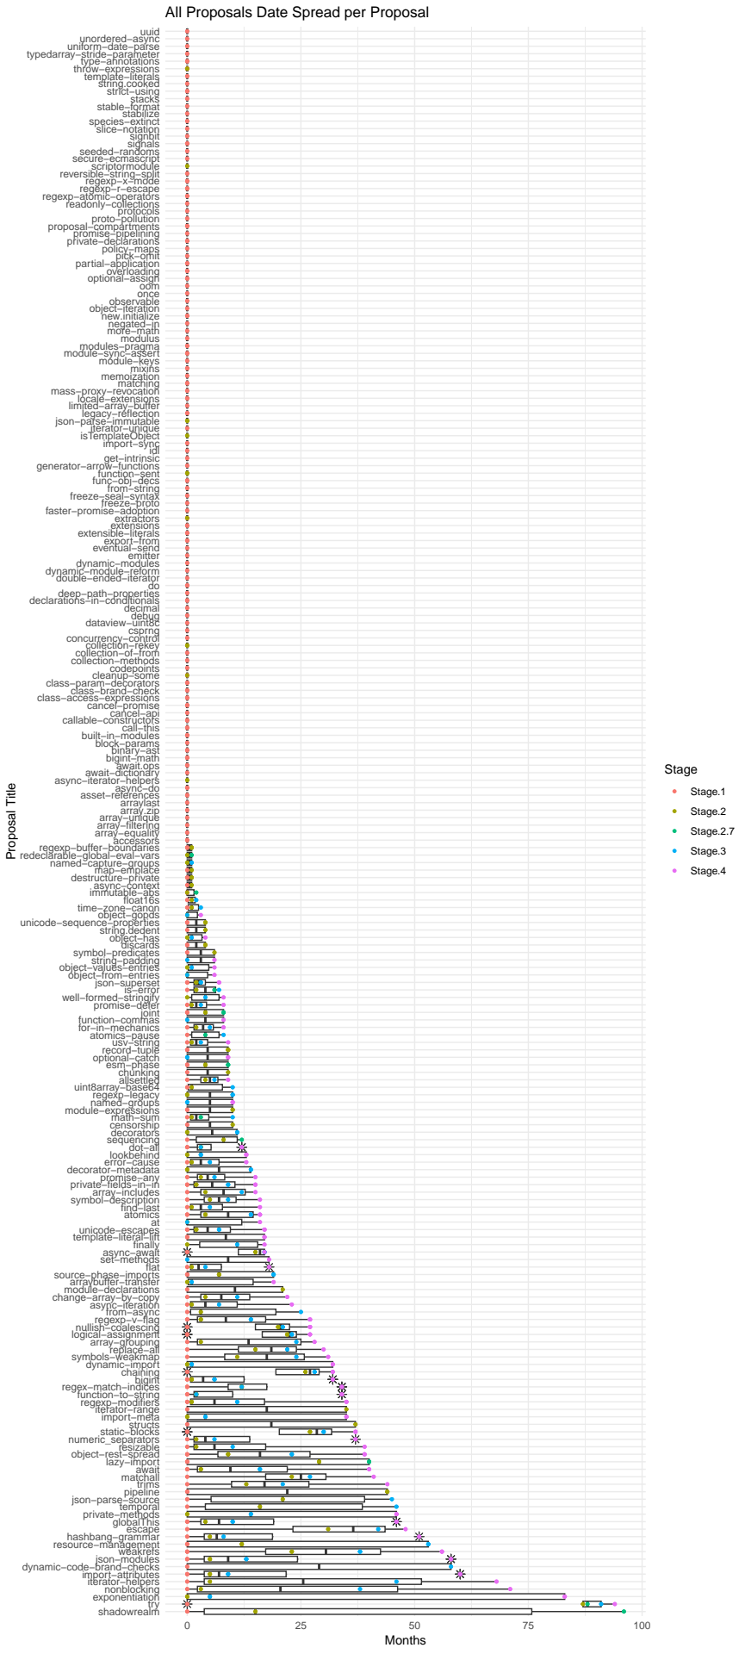
All together
What data can be extracted?
- Classifications
- Stage distribution
- Average duration per stage

Slide 14
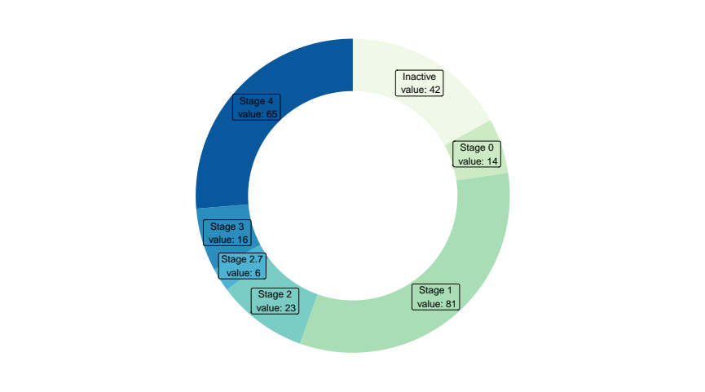
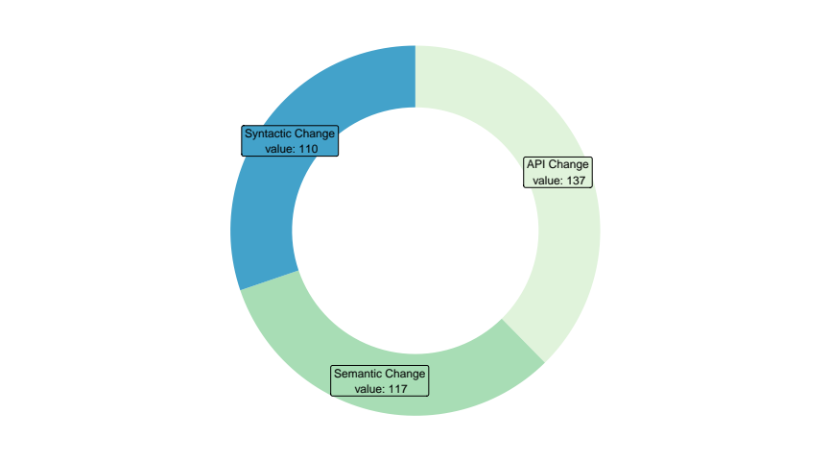
For starters
Total number of proposals: 257
Per Classification:
Note: Proposals can overlap classifications

Slide 15
Lets look at Stage 4
Most complete data set
Data gets skewed by the earlier stages

Slide 16
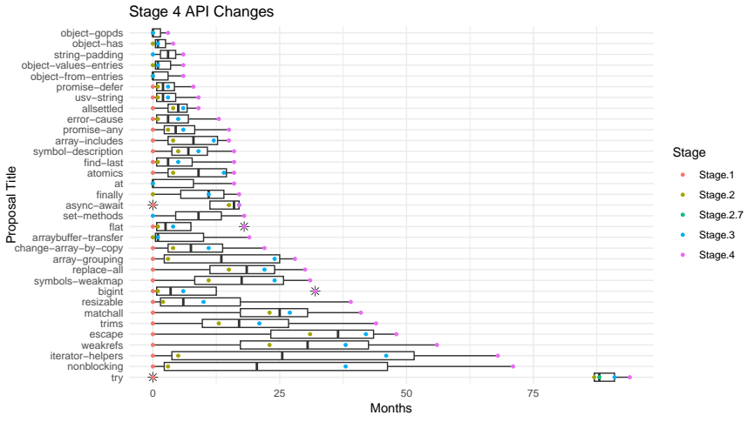
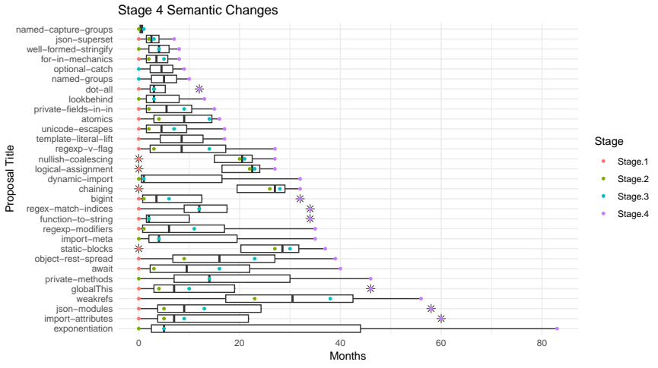
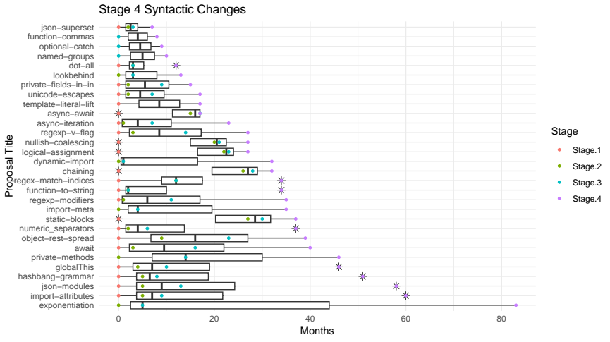
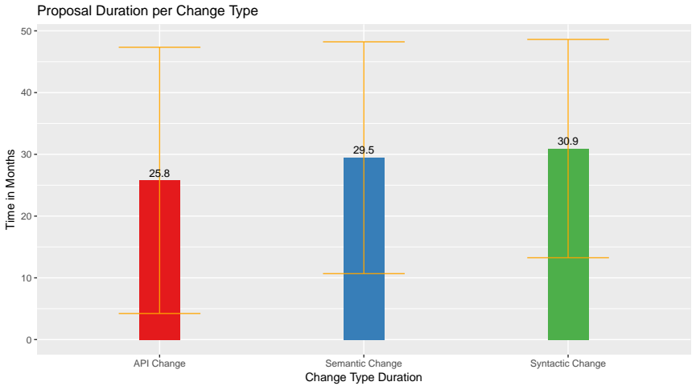
Stage 4: Average Duration per Change

Slide 17
Lets look at more granular classifications
API only
Semantic only
Syntactic only
API and Semantic
API and Syntactic
Semantic and Syntactic
API and Semantic and Syntactic

Slide 18
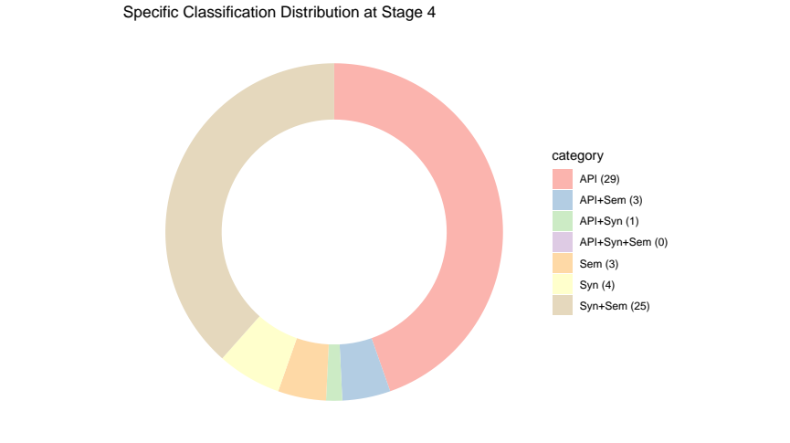
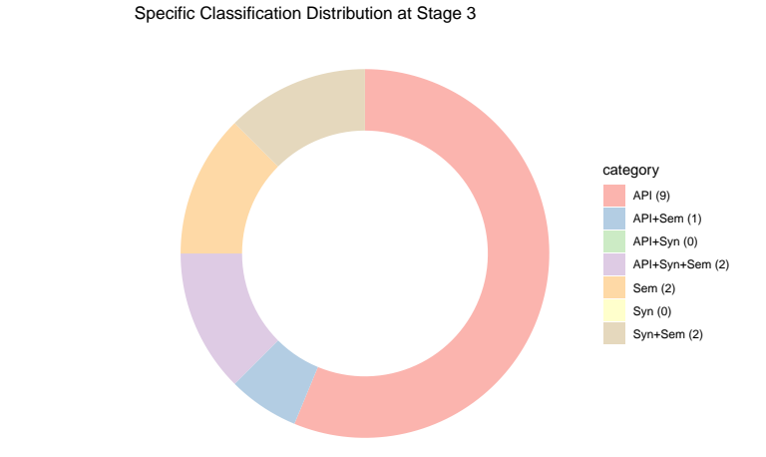
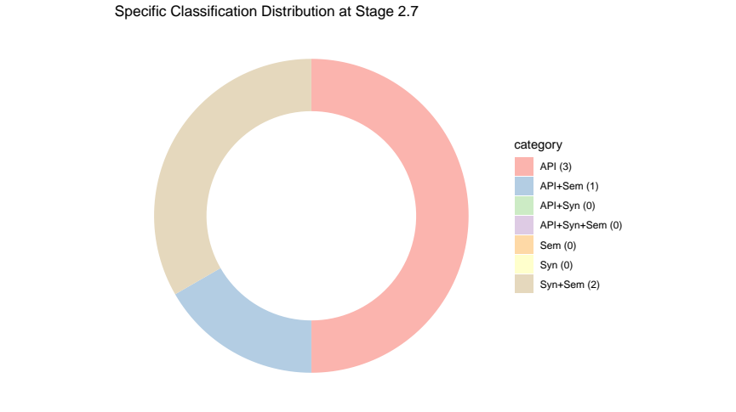
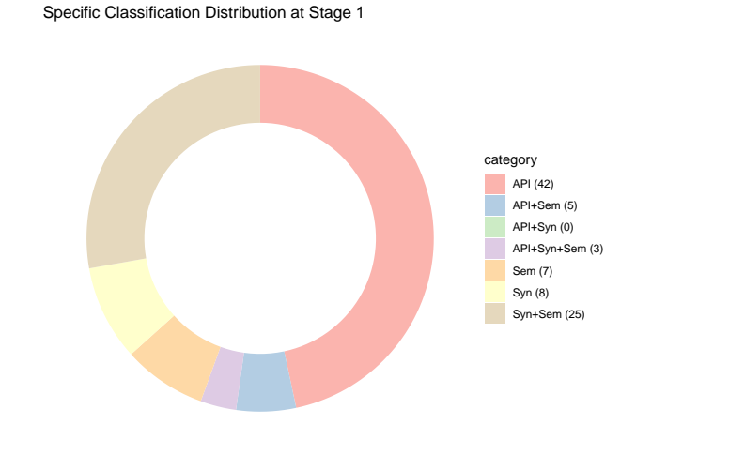
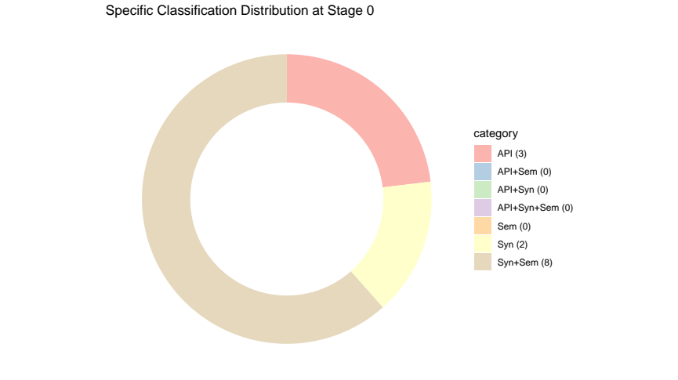
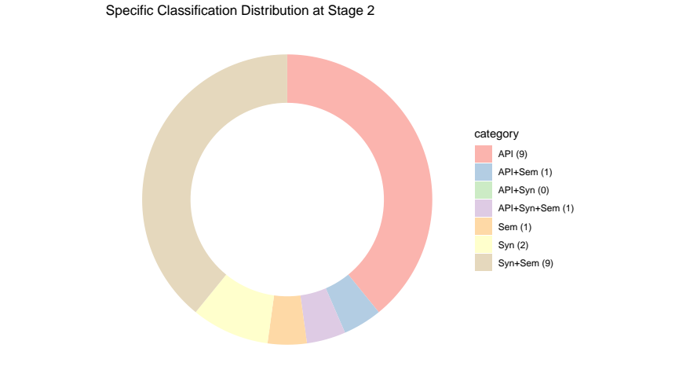
Specific Classifications

Slide 19
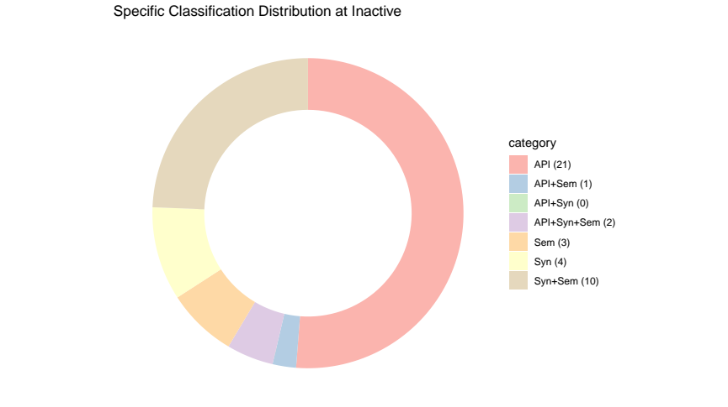
Continuing with Inactive

Slide 20
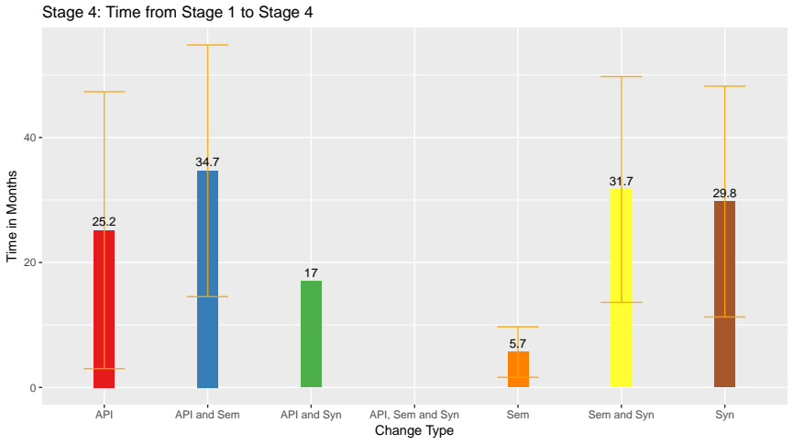
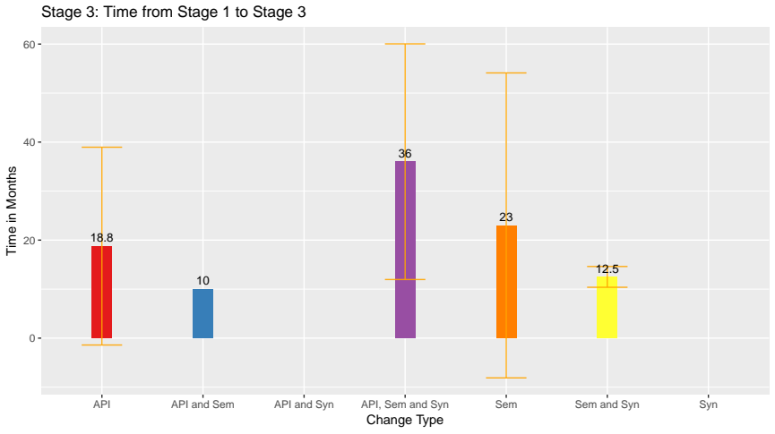
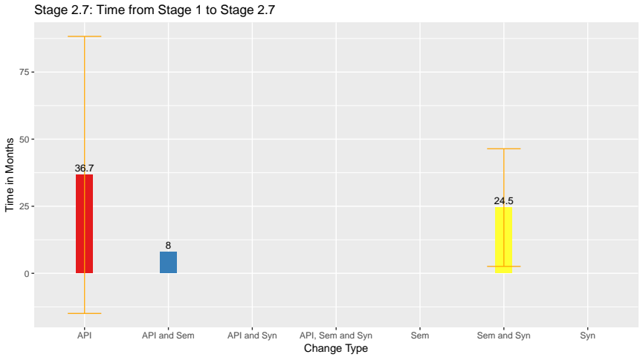
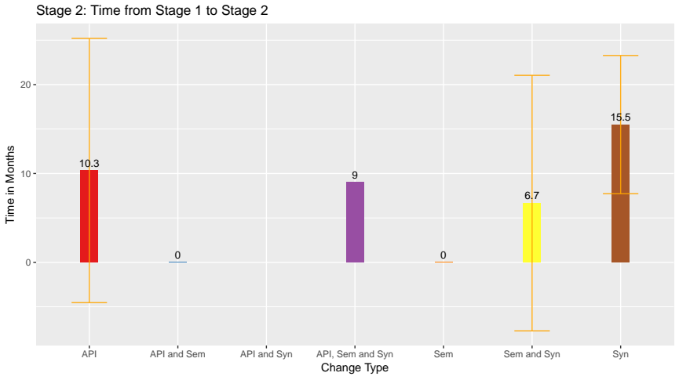
Time From Stage 1

Slide 21
Comparison granular vs overlapping classification

Slide 22
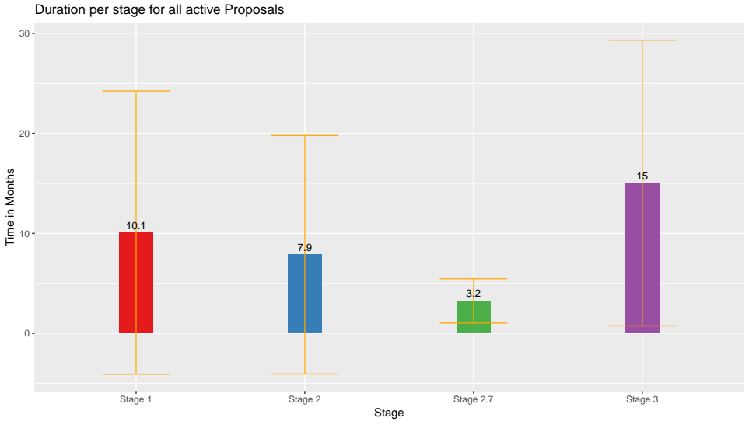
Duration per Stage
Observations:
  Length Stage 3 → Stage 1 → Stage 2 → Stage 2.7
  Large SD
  Stage 2.7 is the smallest group

Slide 23
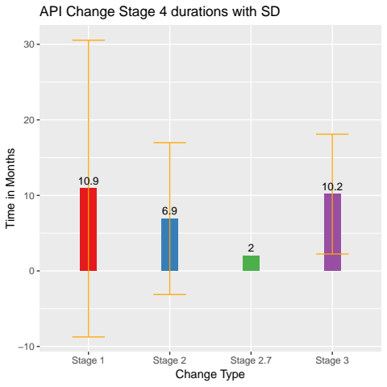
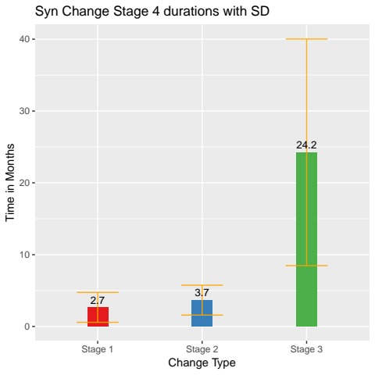
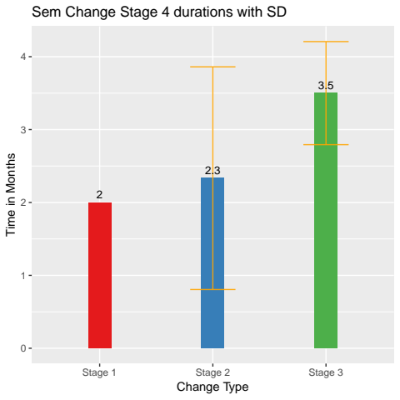
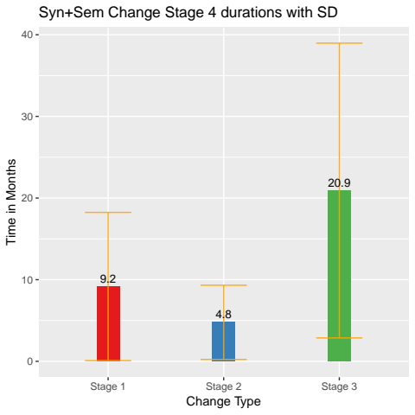
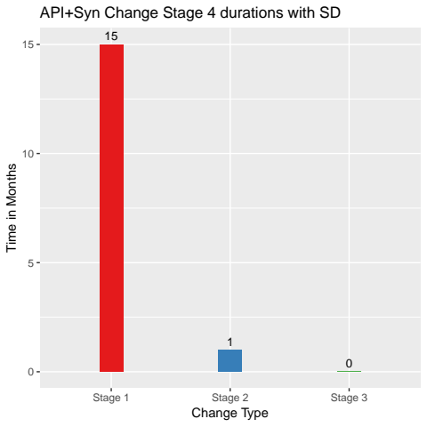
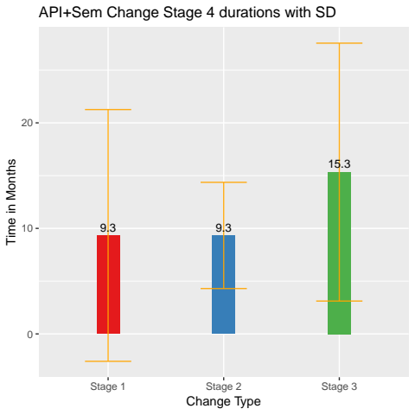
Durations per stage for Stage 4 per classification

Slide 24
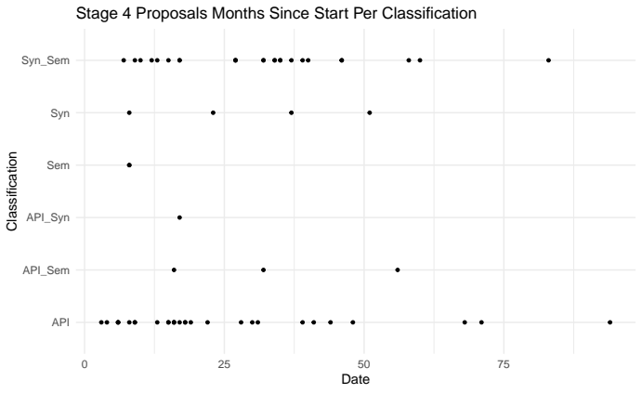
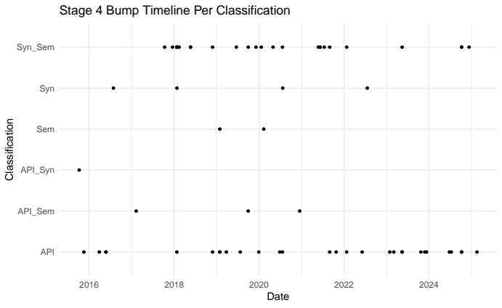
Stage 4 Proposals per Classifications

Slide 25
326 Keywords
Rank | Keywords | n
1 | #performance | 32
2 | #iterator | 26
3 | #asynchronous | 22
4 | #promise | 22
5 | #module | 21
6 | #regex | 20
7 | #array | 19
8 | #property | 19
9 | #class | 18
10 | #security | 18
11 | #string | 17
12 | #error_handling | 15
13 | #memory_management | 15
14 | #typedarray | 12
15 | #concurrency | 10
Rank | Keywords | n
16 | #arithmetic | 9
17 | #destructuring | 8
18 | #map | 8
19 | #numeric | 8
20 | #arraybuffer | 7
21 | #decorator | 7
22 | #json | 7
23 | #math | 7
24 | #unicode | 7
25 | #bigint | 6
26 | #generator | 6
27 | #global | 6
28 | #iterable | 6
29 | #key_value_pairs | 6
30 | #parse | 6
Rank | Keywords | n
31 | #realm | 6
32 | #symbol | 6
33 | #date_time | 5
34 | #encapsulation | 5
35 | #grammar | 5
36 | #metadata | 5
37 | #operator | 5
38 | #pattern_matching | 5
39 | #readability | 5
40 | #resource_management | 5
41 | #set | 5
42 | #string_manipulation | 5
43 | #synchronous | 5
44 | #wait | 5
45 | #accessor | 4

Slide 26
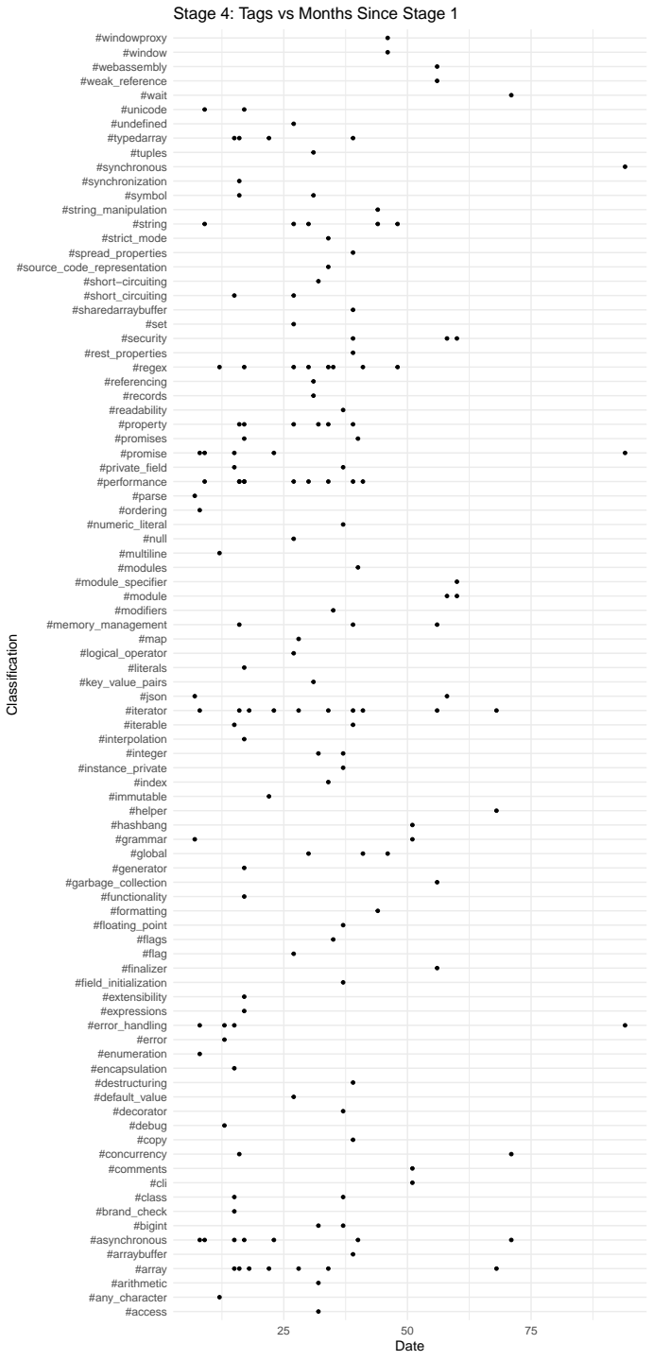
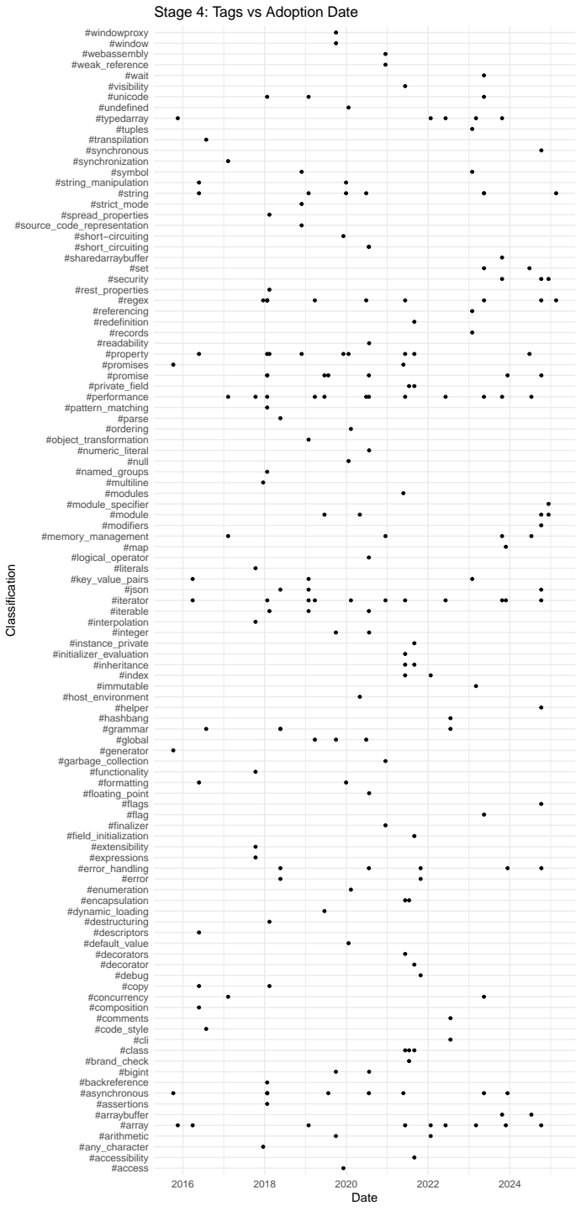
Keywords Continued
Too many keywords
Reduce to 20

Slide 27
Topics
Rank | Topics | Count
1 | #others | 281
2 | #objects | 131
3 | #async | 51
4 | #arrays | 47
5 | #iterators | 45
6 | #modules | 37
7 | #numbers | 36
8 | #performance | 32
9 | #concurrency | 31
10 | #collections | 25
11 | #regex | 25
12 | #security | 23
13 | #memory | 22
14 | #intl | 21
15 | #functions | 12
16 | #types | 11
17 | #realms | 9
18 | #ergonomics | 8
19 | #json | 6
20 | #webassembly | 2
Topics are broader than keywords
Keywords are more individual
Can be refined but this is a starting point

Slide 28
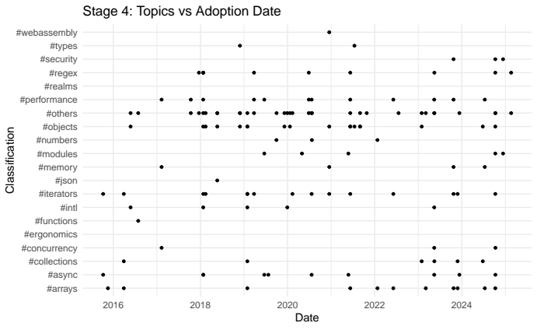

Slide 29
